Slide 1
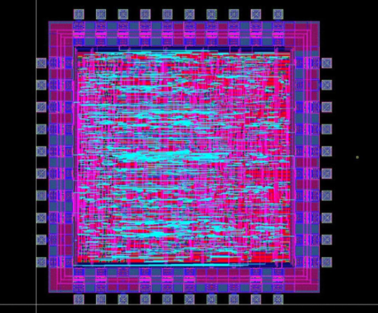

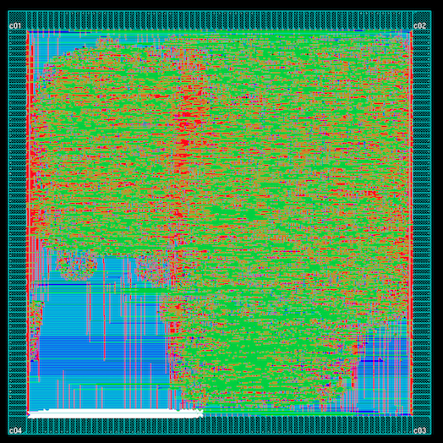
ECE 337 Project Canny Edge Detection Final Presentation
Oluwatosin Adeosun, Sukhyun Hong,
Eric Nielsen, Jiyuan Zhao

Slide 2
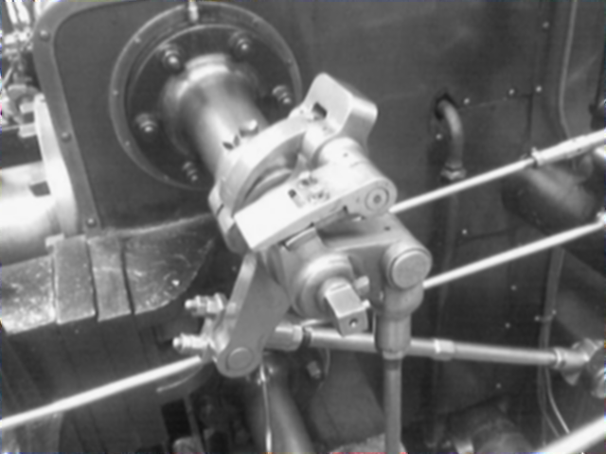
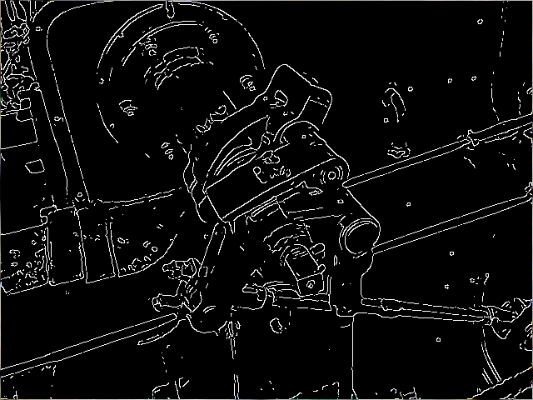
Project Overview
Edge detection using Canny algorithm
Useful feature in image processing
Highlights key features in images
ASIC implementation using pipelining
Large amount of processing power needed
Optimized for speed
Interfacing with 9 off-chip SRAMs
Input/output bitmap images
Four main functional blocks
Image smoothing
Gradient and magnitude calculation
Directional non-maximal suppression
Hysteresis thresholding

Slide 3
System Level Diagram
Input Image
(Bitmap, 512x512 pixels)
Output Image
(Bitmap, 512x512 pixels)
Clk N_Rst Start
Python Script
Python Script
9 Off-Chip SRAMs
(Cypress, CY7C1018DV33)
9 Address Lines (19 bit)
Canny Edge Detection Chip
1 Off-Chip SRAM
(Cypress, CY7C1018DV33)
Address Line (18 bit)
Data Line (8 bit)
9 Data Lines (8 bit)
Write Enable /
Mem Clear /
Mem Dump
Read Enable / Mem Init

Slide 4
Canny Edge Detection Flow Chart
Magnitude Calculation Block
Directional Non-Maximal Suppression Block
Input Image
Data
Output Image Data
Image Smoothing Block (Gaussian)
Horizontal & Vertical Gradient Calculation Block
Hysteresis Thresholding

Slide 5
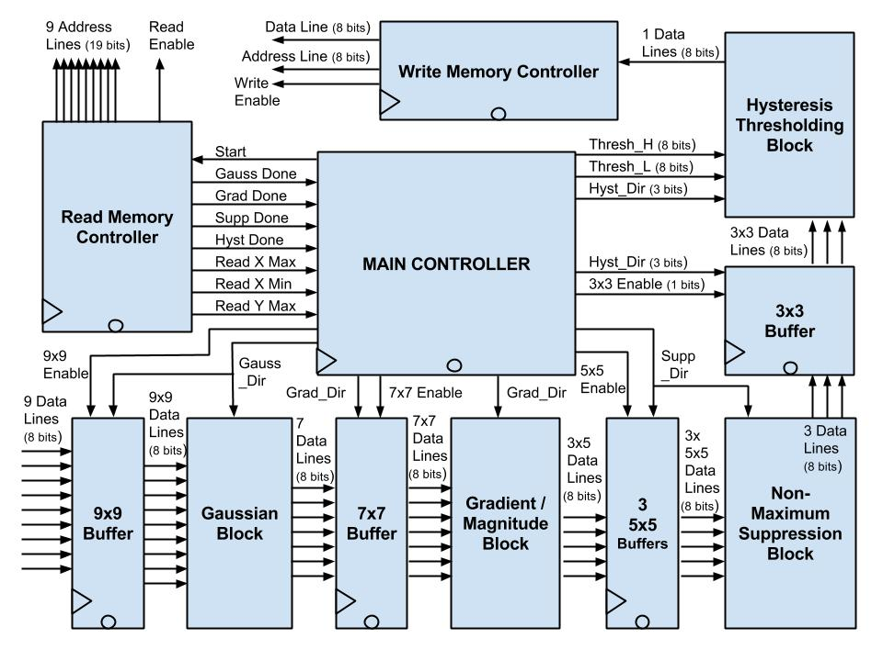
Architecture Diagram

Slide 6
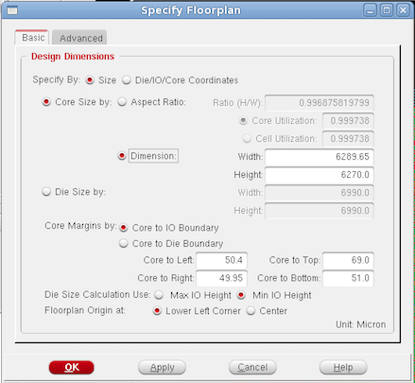
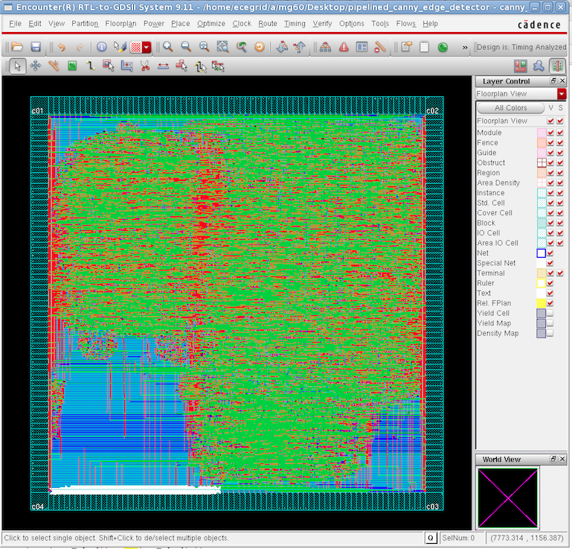
Layout
Core Utilization: 99.97%
Dimensions: 6.29mm x 6.27mm
Layout Critical Path Delay: 11.579 ns
Synthesis Critical Path Delay:
8.81 ns
Budgeted Critical Path Delay:
10.2 ns

Slide 7
Success Criteria
Success Criteria | Points | Status
The design can successfully interface with the off-chip SRAM module (both read and write capabilities). | 1 | In Progress
The Gaussian block of the design operates correctly on original image data. | 1 | Achieved
The Gradient/Magnitude block of the design operates correctly on blurred image data. | 1 | Achieved
The Suppression block of the design operates correctly on the blurred pixel magnitude data. | 1 | Achieved
The Hysteresis block of the design operates correctly on the suppressed pixel data. | 1 | Achieved
The complete design is able to produce an output bitmap image with the edges in the original image accurately detected. | 3 | In Progress

Slide 8


Gaussian Test Results
Expected
Actual

Slide 9

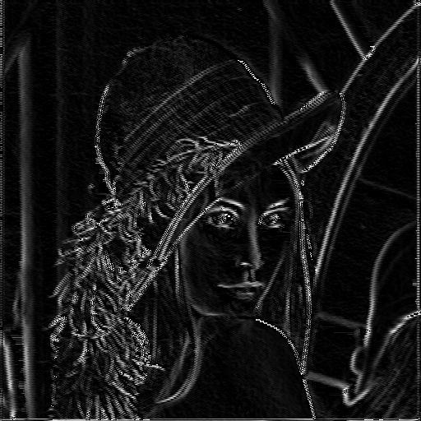
Gradient/Magnitude Test Results
Expected
Actual

Slide 10

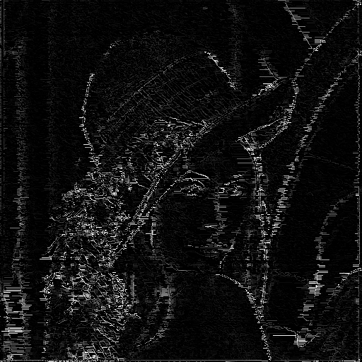
Suppression Test Results
Expected
Actual

Slide 11

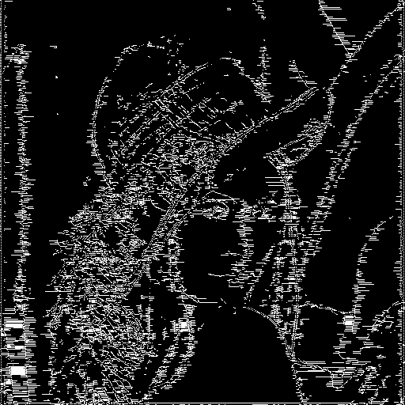
Overall Test Results
Expected
Actual

Slide 12
Conclusions
Challenges
Design of interface with off-chip SRAM
Pipelined data flow approach
Design of buffers/data lines
Timing at image edges
Alternate design approaches
Fewer off-chip SRAMs
Slower performance
Much smaller chip size
Integrate Python functionality into test-bench for easier operation
Possible improvements
Support for multiple image sizes
Auto-calculation of hysteresis thresholds

Slide 13
Questions?

Slide 14
Supporting Slides

Slide 15
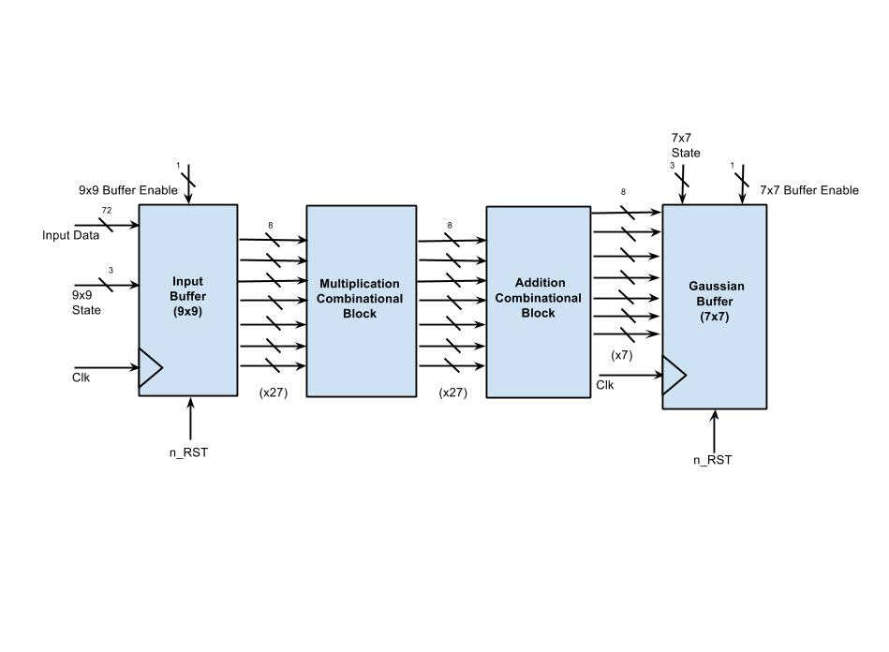
Image Smoothing (Gaussian)

Slide 16
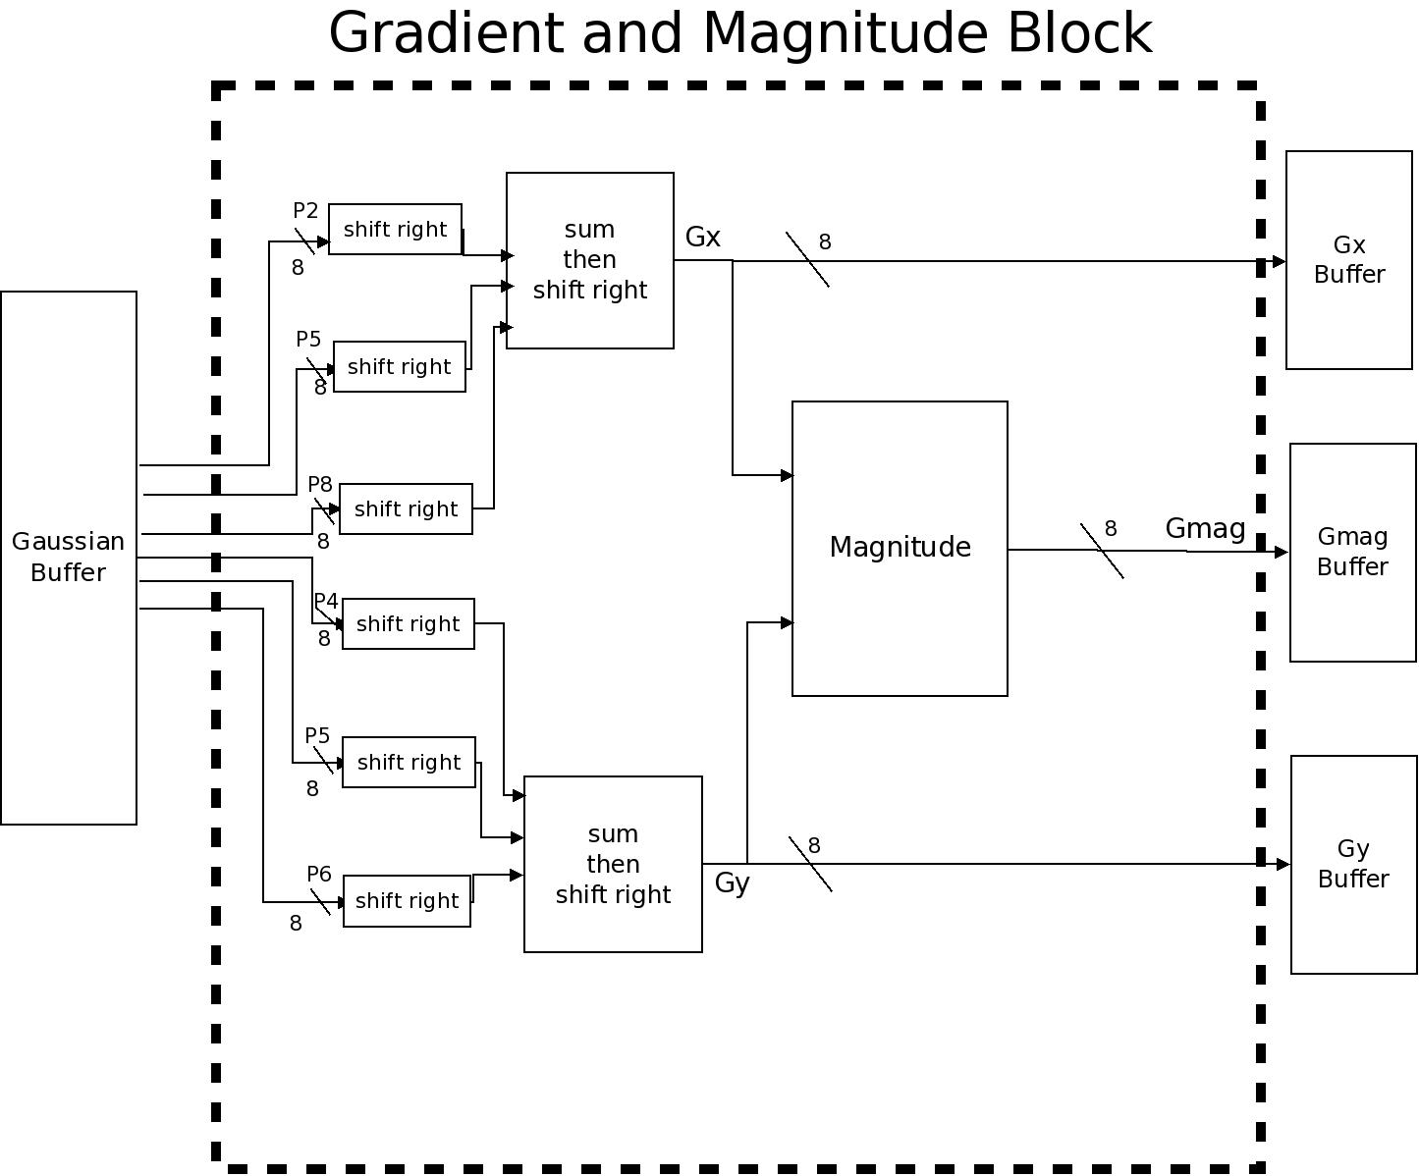
Gradient/Magnitude Calculation
x5

Slide 17
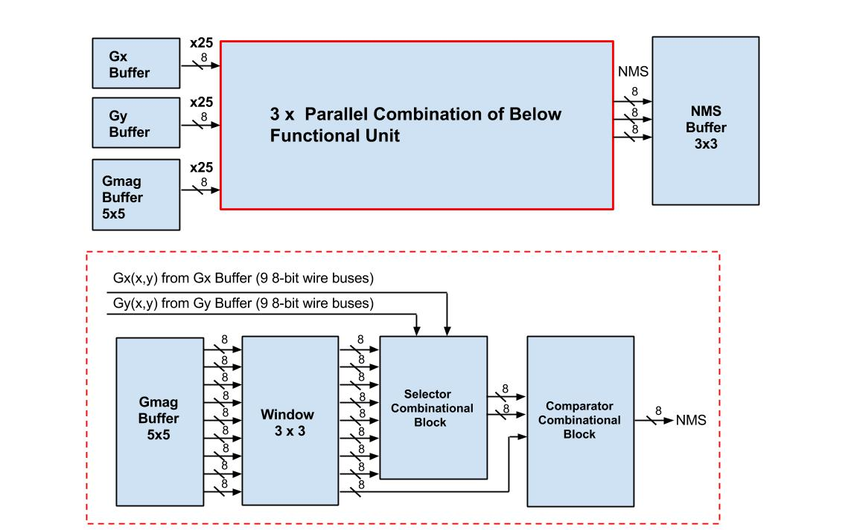
Directional Non-Maximal Suppression

Slide 18
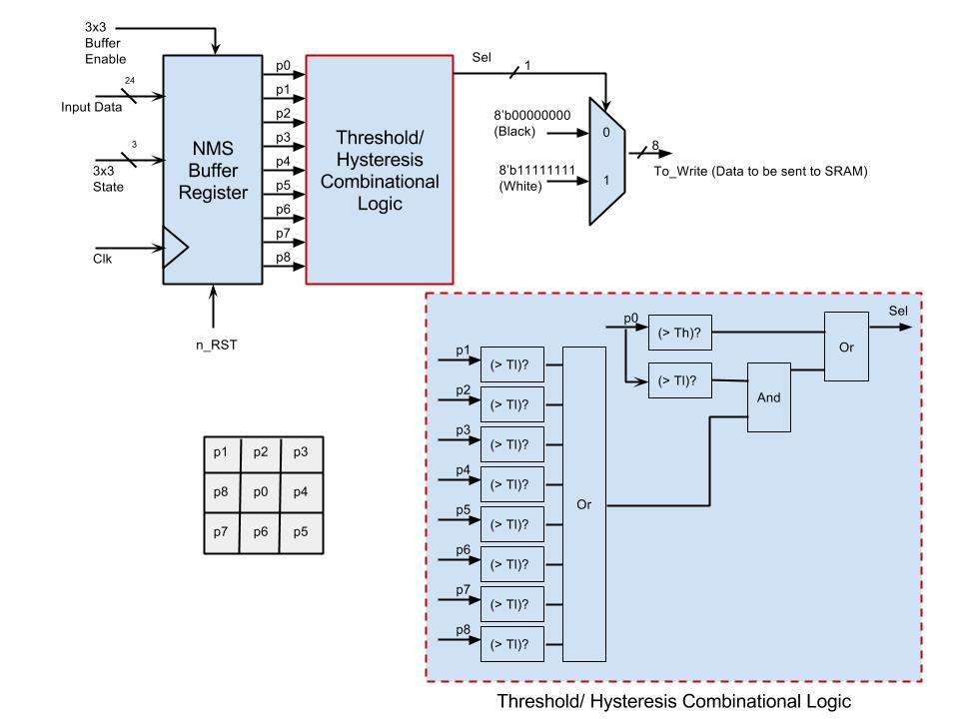
Hysteresis Thresholding

Slide 19
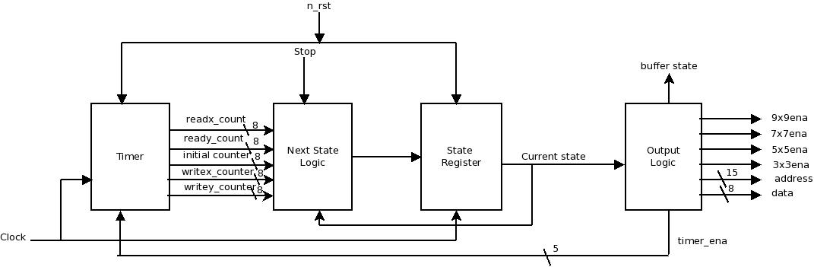
Main Controller RTL Diagram

Slide 20
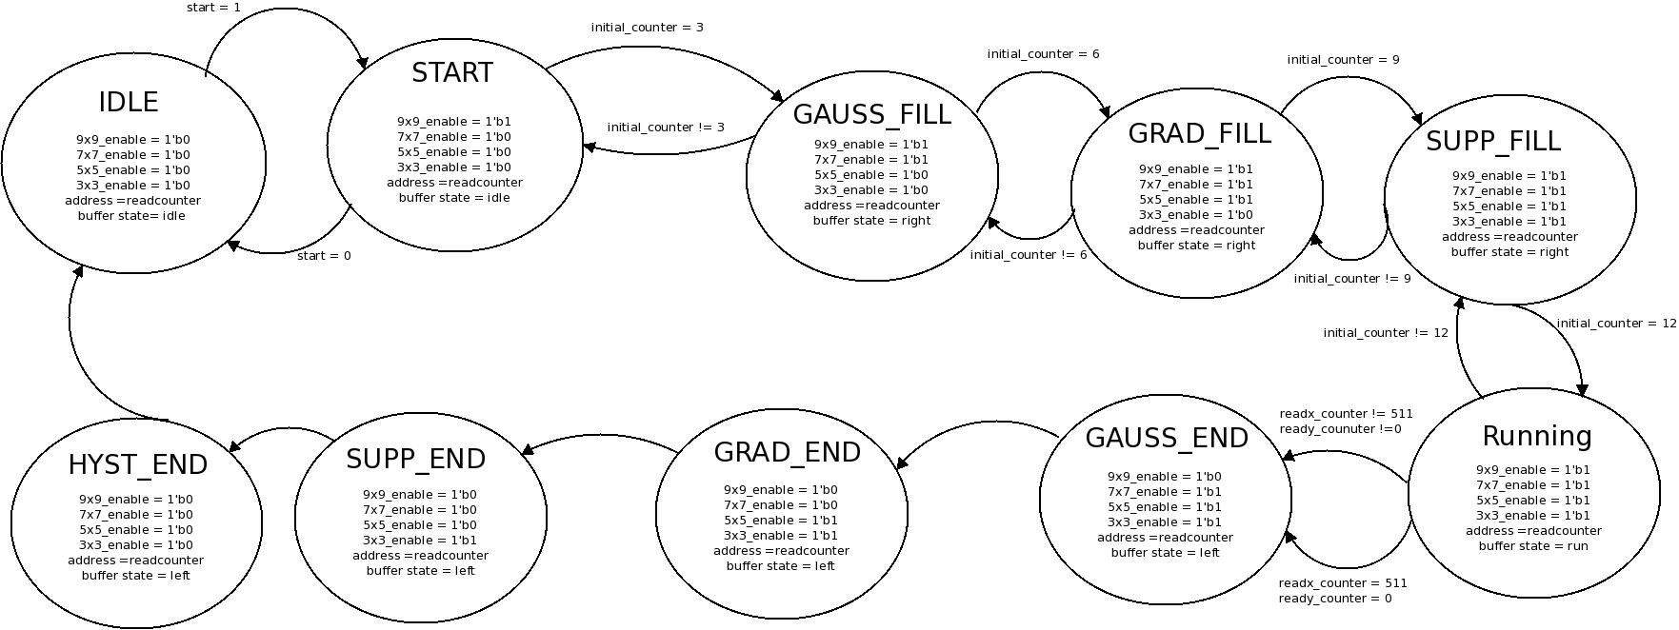
Main Controller State Diagram (Summary)

Slide 21
Area & Timing Budgets
Block Name | Gate/FF Count | Area (um²) | Total Path Delay (ns) | Target Clock Period (ns)
Gaussian (slide 6) | 1,944 | 2,527,200 | 5.2 | 10
Gradient/Mag (slide 7) | 3,432 | 3,220,800 | 6.2 | 10
Directional Non-Maximal Suppression (slide 8) | 3,480 | 3,600,00 | 3.2 | 10
Hysteresis Thresholding (slide 9) | 113 | 203,550 | 1.6 | 10
Main Controller and Timer (slide 11) | 106 | 224,700 | 10.2 | 10
Total Core Dimensions:
3,091x3,091 um²
Total I/O Padframe Dimensions:
2,805x2,805 um² (98 I/O pads)

